Slide 1

Automation QA Report
Android Test Environment
13 February 2025

Slide 2





Android Executive Summary
QA RAG STATUS RAG STATUS
Pass 367 Test Cases
Defects 5 Deferred
Risks
1 open
Impediments
4 Impediments
No Runs
32 Test Cases
Defects
5 Deferred – Settings(Troubleshooting log cell, )
In-App Calling-Start a call(Vitality, Gap cover, Car and home insurance, Life insurance)
Status
Daily execution was run on the latest build
2025.02.02.0 (#99137) on Samsung S21 (Android 14)
Security Patch level: 1 November 2024
2025.02.02.0 (#99137) on Samsung S22 (Android 14),
Security Patch level: 01 December 2024
Execution Time: 08h00 – 11h00
Risks
❖ Features ran affected by the service being
down during execution(FAZ, Business
Overview graph, Individual life)
Risks

Slide 3
Android Test Execution Summary
Completed Tests
Unexecuted Tests
92%
8%

Slide 4
Android Defect Summary

Slide 5
Android Defect Description
ID | Feature Affected | Defect Summary | Defect Steps | Severity | Status | Date Detected | Platform | Device | Assignee
8174 | Settings | Settings: User: test--aturi/feedmeseymour1 Expected results: Record troubleshooting logs cell should be on display. Actual results: Record troubleshooting logs cell not on display | 1. Login Flow 2. Click more 3. Click Settings 4. Record Troubleshooting Logs cell. | Low | Deferred | 04 May 2023 | Android 14 | Samsung Galaxy S22 | Molemo Tseleng

Slide 6
Android Defect Description
ID | Feature Affected | Defect Summary | Defect Steps | Severity | Status | Date Detected | Platform | Device | Assignee
15946 | In App Calling : (Gap Cover) Start a call using data | In App Calling : Gap Cover User: test--1005134026 - feedmeseymour1 Expected results: User should be able to start a call Actual results: Could not retrieve information please try again later | 1. Login Flow 2. Click Recommenders: Gap Cover 3. Click call us now 4. Select Call us with data 5. Click Start call | Low | Deferred | 16 October 2024 | Android 14 | Samsung Galaxy S21 | Molemo Tseleng
14388 | In App Calling : (Classic Life Plan) Start a call using data | In App Calling: Classic Life Plan User: test--1000402352 - feedmeseymour1 Expected results: User should be able to start a call Actual results: Could not retrieve information please try again later | 1. Login Flow 2. Click Recommenders: Classic Life Plan 3. Click call us now 4. Select Call us with data 5. Click Start call | Low | Deferred | 18 November 2024 | Android 14 | Samsung Galaxy S21 | Molemo Tseleng

Slide 7
Android Defect Description
ID | Feature Affected | Defect Summary | Defect Steps | Severity | Status | Date Detected | Platform | Device | Assignee
14984 | In App Calling : (Vitality) Start a call using data | In App Calling : Vitality User: test--1004853055 / test--1000091122 - feedmeseymour1 Expected results: User should be able to start a call Actual results: Could not retrieve information please try again later | 1. Login Flow 2. Click Recommenders: Vitality 3. Click call us now 4. Select Call us with data 5. Click Start call | Low | Deferred | 13 April 2024 | Android 14 | Samsung Galaxy S22 | Molemo Tseleng
14982 | In App Calling : (Car and Home) Start a call using data | In App Calling : Car and Home User: test--1000211449 / feedmeseymour1 Expected results: User should be able to start a call Actual results: Could not retrieve information please try again later | 1. Login Flow 2. Click Recommenders: Car and Home Insurance 3. Click call us now 4. Select Call us with data 5. Click Start call | Low | Deferred | 13 April 2024 | Android 14 | Samsung Galaxy S22 | Molemo Tseleng

Slide 8
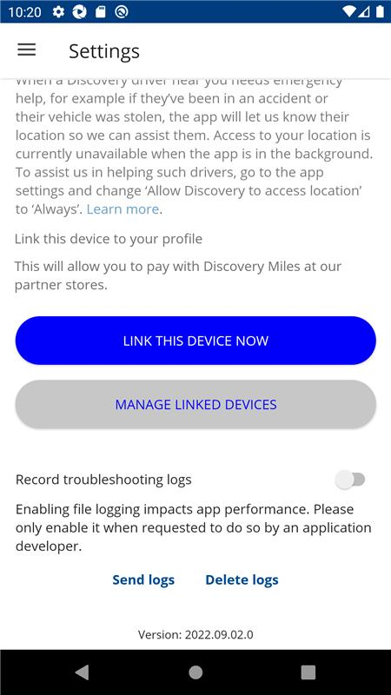
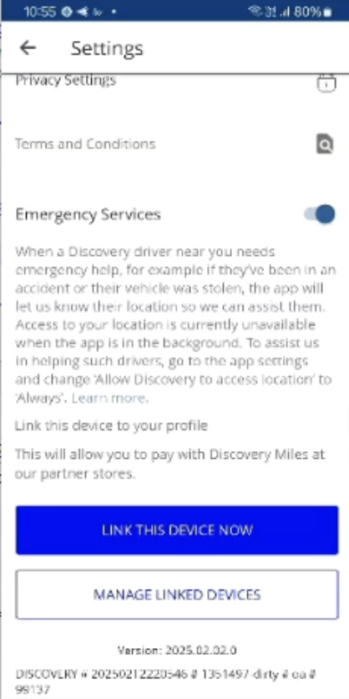
Android Defect Screenshot
Settings: Reference, Record troubleshooting logs cell on display
Deferred- Settings: Current
image, Record troubleshooting logs cell not on display

Slide 9
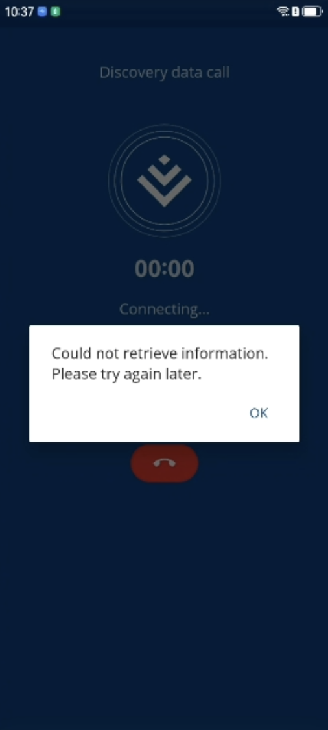
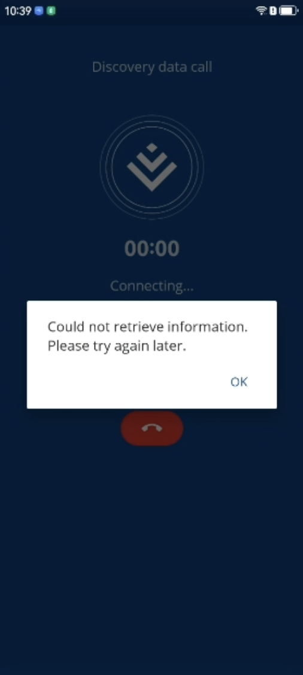
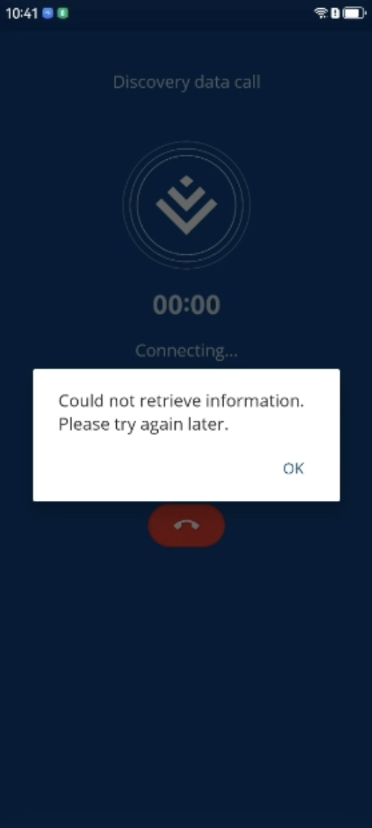
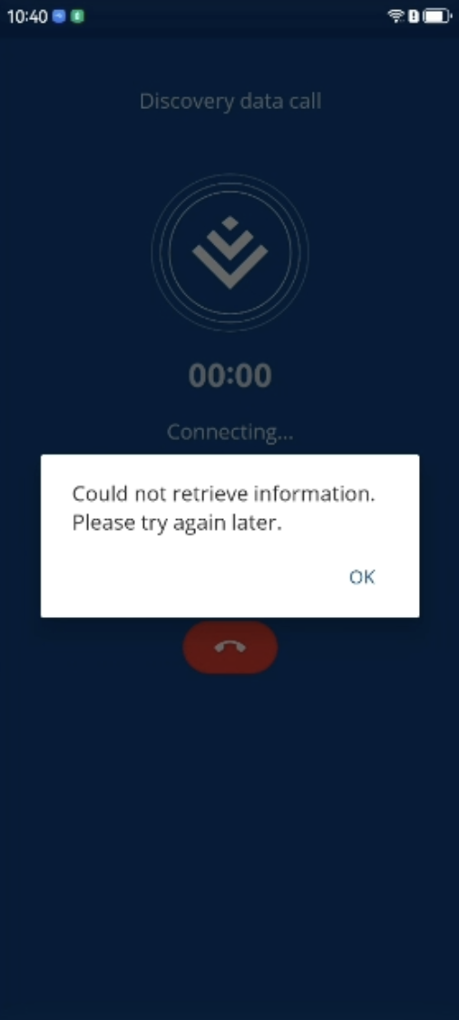
Android Defect Screenshot
Technocenter | Discovery Central Services | QA Status Report
Deferred - In App Calling : Life Insurance
Deferred - In App Calling : Vitality
Deferred - In App Calling : Gap Cover
Deferred - In App Calling: Car and Home Insurance

Slide 10

 |  |  | Samsung Galaxy S22 (Android 14)
No | Feature | Test Case |  | Issue Summary
1 | Login | Verify user is able Login successful using username & password
 |  | Verify user logs in that hasn't accepted T's and C's yet
 |  | Verify logged in user can logout
 |  | Verify Login with empty username and valid password
 |  | Verify Login with empty username and empty password
2 | Terms & Conditions | Verify if user can view Terms & Conditions after login
 |  | Verify if user can accept Terms & Conditions
3 | Device Registration | Verify that link device button is displayed when there is no devices linked
 |  | Verify if user can link device
 |  | Verify that user can view 'manage linked devices
Android Test Execution Details

Slide 11

 |  |  | Samsung Galaxy S22 (Android 14)
No | Feature | Test Case |  | Issue Summary
 |  | Verify that if Device registered, when logging in again we do not prompt you with mandatory registration again
 |  | Verify user can delete trusted device
 |  | Verify tapping link device now on link device screen navigates user to screen with title as OTP(One-Time-Pin)
 |  | Verify I am able validate manage Delink a device
 |  | Verify tapping DELINK button displays You are about to delink device pop up message
 |  | Verify tapping DELINK button navigates user to OTP screen
4 | In-App Account Deletion | Verify user is able to Login successful using username & password
 |  | Verify user is able to see/get 'Data access and deletion request'
 |  | Verify user is able to see/get 'Data access and deletion request'
Android Test Execution Details

Slide 12
 |  |  | Samsung Galaxy S22 (Android 14)
No | Feature | Test Case |  | Issue Summary
5 | Forgot Username Using Email | Verify user can click forget Username
 |  | Verify user can enter valid email address to get username
 | Forget Username Using SA ID Number | Verify user can click forget Username
 |  | Verify user can enter valid cellphone number to get username
 |  | Verify user can enter valid SA ID number
6 | Forget Password using email | Verify user can click forget password
 |  | Verify user can enter valid email address to change password
 | Forget Password using SA ID Number | Verify user can click forget Password
 |  | Verify user can enter valid cellphone number to get username
 |  | Verify user can enter valid SA ID number
Android Test Execution Details

Slide 13
 |  |  | Samsung Galaxy S22 (Android 14)
No | Feature | Test Case |  | Issue Summary
7 | Profile | Verify that user is able to click Profile and view my profile page
 |  | Verify user is able to update profile picture
 |  | Verify that I am able to click Data Access and Deletion Requests on Profile landing
 |  | Verify that I am able to tap Personal Details on Profile landing and validate Personal Details screen
 |  | Verify that I am able to tap Contact Details on Profile landing and validate Contact Details screen
 |  | Verify that I am able to tap Update Bank Details on Profile landing and validate Update Bank Details screen
 |  | Verify that I am able to tap Emergency Assist on Profile landing and validate Emergency Assist screen
Android Test Execution Details

Slide 14
 |  |  | Samsung Galaxy S22 (Android 14)
No | Feature | Test Case |  | Issue Summary
 | Profile | Verify user is able to see Terms and conditions
 |  | Verify tapping "Emergency assist " cell for user who has completed details navigates user to Emergency assist screen
 |  | Verify "Medical emergency " section on the "Emergency Assist " screen
 |  | Verify I am able to tap Update contact details" button on Emergency assist screen an update contact details
 |  | Verify I am able to see and tap cell with title as Communication Preferences
 |  | Verify I am able to see, tap Emergency details and validate the "Emergency details " screen
Android Test Execution Details

Slide 15
 |  |  | Samsung Galaxy S22 (Android 14)
No | Feature | Test Case |  | Issue Summary
8 | Discovery Pay | Verify tapping "Discovery Pay " cell under Manage section on the More screen navigates user to Discovery Pay screen
 |  | Verify tapping Health Pay and validating Health Pay Page
 |  | Verify tapping "Learn More" at the bottom of the Discovery Pay screen navigates you to a web-breakout
 |  | Verify tapping the back arrow button on the "Discovery Pay" screen navigates you to the Home View screen
Android Test Execution Details

Slide 16
Android Test Execution Details
 |  |  | Samsung Galaxy S22 (Android 14)
No | Feature | Test Case |  | Issue Summary
9 | Digital Cards | Verify tapping Digital Cards cell under Manage section on the More screen navigates user to screen with title as Digital Cards
 |  | Verify display of Digital Cards screen
 |  | Verify view of Digital Card Information on the first card
 |  | Verify view of Digital Card Information on the second card
 |  | Verify view of Digital Card Information on the third card
 |  | Verify view of Digital Card Information on SK digital card
 |  | Verify user is able to see Digital Card Information page
 |  | Verify user can delete cards
 |  | Verify user can restore cards
 |  | Verify there are no cards under ” Deleted digital Card ” after the card has been restored
 |  | Verify user can click info icon on Digital cards

Slide 17

 |  |  | Samsung Galaxy S22 (Android 14)
No | Feature | Test Case |  | Issue Summary
10 | Settings | Verify tapping Settings under Manage section on the More screen and validating Settings screen
 |  | Verify tapping Privacy Settings under Settings screen and validating Privacy settings screen
 |  | Verify I am able to tap "Terms and Conditions" cell on Settings screen
 |  | Verify I am able to tap version text seven times to see more details about the app
 |  | Verify I am able to view "Link my device" option for user with Miles
 |  | Verify I am able to see "Emergency Services" cell
 |  | Verify I am able to see ”Record Troubleshooting logs" cell |  | Record Troubleshooting logs not displayed
Android Test Execution Details

Slide 18
 |  |  | Samsung Galaxy S22 (Android 14)
No | Feature | Test Case |  | Issue Summary
11 | Privacy Policy | Verify I am able to click and validate Privacy Policy page
 |  | Verify dismissing privacy policy in-app web view navigates user to the More screen
12 | Scan a code | Verify I am able to click and validate Scan Code page
 |  | Verify tapping Scan a code cell under Manage section on the More screen navigates user to screen with title as Scan
13 | Virtual Agent-Bot Icon | Verify I am able to click Virtual Bot on the Home screen
 |  | Verify I am not able to view virtual agent bot icon on the Home screen(Test account specific)
Android Test Execution Details

Slide 19
 |  |  | Samsung Galaxy S22 (Android 14)
No | Feature | Test Case |  | Issue Summary
 | Bottom Nav (Emergency Assist Entry Point) | Verify Push notification pop-up displays when member logs in
 |  | Verify user is able to Dismiss Emergency Screen
 | Bottom Nav (Home Screen) | Verify User with Discovery products is able to see products relevant to their profile on Home screen
 |  | Verify drilling down/tapping on the cells on the Home screen navigates user to the product landing screens (i.e. Vitality, Insure, Life, Invest, Medical Aid landing )
 |  | Verify Product landing screen display a back button in the top left corner of the screen
 |  | Verify Product landing screen display a back button in the top left corner of the screen.
 |  | Verify Product landing screen display a back button in the top left corner of the screen.
 | Bottom Nav (Secure Inbox) | Verify tapping Inbox tab on bottom navigation bar navigates user with a Discovery product to screen with title as Inbox
 |  | Verify text on Inbox screen displays as follows icon, Welcome to your secure inbox and text All of the communication...
 |  | Verify tapping View secure inbox button navigates user to web breakout
 |  | Verify dismissing Secure inbox web breakout navigates user to Inbox screen
Android Test Execution Details

Slide 20
 |  |  | Samsung Galaxy S22 (Android 14)
No | Feature | Test Case |  | Issue Summary
 | Bottom Nav (More) | Verify tapping More tab on bottom navigation bar navigates user navigates user to screen with title as More
 |  | Verify user is able to see the below section heading on More screen based on what is relevant to users profile/products
 |  | Verify the cells displayed on the More screen are hidden based on what is relevant to users profile/products
 |  | Verify that the cells listed below are displayed under the Manage section heading based on the users active products on their profile.
 |  | Verify that the cells listed below are displayed under the Documents section heading based on the users active products on their profile
 |  | Verify that the cells listed below are displayed under the Info section heading based on the users active products on their profile.
 |  | Verify FAZ section heading is displays for Financial advisors on More screen
Android Test Execution Details

Slide 21
 |  |  | Samsung Galaxy S22 (Android 14)
No | Feature | Test Case |  | Issue Summary
 |  | Verify Rewards Statement cell is displayed under Manage section heading for users eligible to view statement
 |  | Verify that the cell is below displays under the Settings section for users
 |  | Verify that the bottom navigation bar is showing on all of the screen listed below
 |  | Verify Log out cell is displaying on the Bottom section of the More screen
Android Test Execution Details

Slide 22

 |  |  | Samsung Galaxy S22 (Android 14)
No | Feature | Test Case |  | Issue Summary
15 | Visit a Discovery Store | Verify I am able to tap on Visit a Discovery Store under Manage section on the More screen
 |  | Verify dismissing Visit a Discovery store in app view navigates user to More screen
16 | Living the decree | Verify I am able to tap on Living the decree cell under Info section on the More screen
 |  | Verify dismissing Living the decree in app web view navigates user to More screen
17 | Discovery News | Verify I am able to click and validate Discovery News
 |  | Verify I am able to click an article |  | No Discovery latest news articles
 |  | Verify I am able to see a list of available articles on discovery news screen |  | No Discovery latest news articles
 |  | Verify click Find out more |  | No Discovery latest news articles
 |  | Verify tapping on cancel button navigates user to Discovery News screen |  | No Discovery latest news articles
Android Test Execution Details

Slide 23
 |  |  | Samsung Galaxy S22 (Android 14)
No | Feature | Test Case |  | Issue Summary
18 | More screen-Submit a claim | Verify I am able to see "Submit a claim" cell under Documents section on the More screen
 |  | Verify tapping Submit a claim" button under Info section on the More screen navigates user to screen with title as Sumit a claim
19 | Request a document | Verify I am able to click and validate Request document
20 | Find a partner | Verify I am able to click and validate Find a partner
21 | More screen – Get help screen | Verify I am able to click Get Help cell
 |  | Verify I am able to click Get Help on Products
Android Test Execution Details

Slide 24

 |  |  | Samsung Galaxy S22 (Android 14)
No | Feature | Test Case |  | Issue Summary
 |  | Verify I am able to see Contextual alert on the Home screen
22 | Home Contextual Alerts | Verify the latest Contextual alert is displayed
 |  | Verify the view of the Contextual Alert
 |  | Verify tapping dismiss button on Contextual Alert dismisses the Alert
Android Test Execution Details

Slide 25
 |  |  | Samsung Galaxy S21 (Android 14)
No | Feature | Test Case |  | Issue Summary
 | In-app calling (Medical Aid) | Verify user is able to view Medical Aid Screen
 |  | Verify user is able to click Contact us and validate contact us page
 |  | Verify user is able to click and validate call us now screen
 |  | Verify I am able to tap on "Start Call" button on the "Call us now" screen via the Wi-Fi Hospital journey
 | In-app calling (Gap Cover) | Verify I am able to see “Call us” header on Gap Cover Recommender screen
 | In-app calling (Classic Life) | Verify I am able to see “Call us” header on “Life Insurance” Recommender screen
 | In-app calling (Car and Home Insurance) | Verify I am able to see “Call us” header on “Car and Home” Recommender screen
 | In-app calling (Vitality) | Verify I am able to see “Call us” header on “Vitality” recommender screen
 | In-app calling (Medical Aid) | Verify I am able to see “Call us” header on “Medical Aid” Recommender screen
 | In-app calling (Bank) | Verify I am able to see “Call us” header on “Bank” Recommender screen
 | In-app calling (Vitality) | Verify I am able to see “Call us” header on “Invest” Recommender screen
Android Test Execution Details

Slide 26
Android Test Execution Details
 |  |  | Samsung Galaxy S21 (Android 14)
No | Feature | Test Case |  | Issue Summary
 | In-app calling (Recommendations) | Verify I am able to tap on "Start Call" button on the "Call us now" screen via the Recommendations |  | Error message "Could not retrieve information please try again later”
 |  | Verify I am able to terminate a Discovery data call from the "Call us now" screen via the Recommendations

Slide 27
 |  |  | Samsung Galaxy S21 (Android 14)
No | Feature | Test Case |  | Issue Summary
24 | Public Registration | Verify tapping registration button on Discovery login screen navigates user to Registration Screen
 |  | Verify registration page content
 |  | Verify I am able to see and click "I am new to discovery” option
 |  | Verify registered member OTP page content
 |  | Verify I am able to see option "I am new to discovery”
25 | Online Payment | Verify I am able to see Health Account status on the More screen
 |  | Verify tapping Health Account status navigates user to screen with title as "Account Status"
 |  | Verify tapping Make Payment button navigates user to make Payment screen |  | Make Payment button is not displayed
Android Test Execution Details

Slide 28
 |  |  | Samsung Galaxy S21 (Android 14)
No | Feature | Test Case |  | Issue Summary
26 | Recommenders and NBOs | Verify I am able to see and validate Gap Cover Recommender
 |  | Verify user is able to see and click Gap Cover NBO
 |  | Verify user is able validate Gap Cover NBO
 |  | Verify user is able to see and click Let Us call you now
 |  | Verify user is able to see and click Get a Quote button on Gap Cover NBO leads screen
 |  | Verify I am able to see and validate Life Insurance Recommender
 |  | Verify user is able to see and click Life Insurance NBO
 |  | Verify I am able to see and validate Car and Home Insurance Recommender
 |  | Verify user is able to see car and home insurance NBO on Home Screen
Android Test Execution Details

Slide 29
 |  |  | Samsung Galaxy S21 (Android 14)
No | Feature | Test Case |  | Issue Summary
 | Recommenders and NBOs | Verify I am able to see and validate Vitality Recommender
 |  | Verify user is able to see Vitality NBO
 |  | Verify user is able validate Vitality NBO
 |  | Verify user is able to see and click Let Us call you now
 |  | Verify user is able to see and click Get a Quote button on Vitality NBO leads screen
 |  | Verify I am able to see and validate Medical Aid Recommender
 |  | Verify is able to click and validate Medical Aid NBO
 |  | Verify I am able to see and validate Flexicare Recommender
 |  | Verify user is able to see and validate Flexicare NBO
 |  | Verify user is able to see and click Get a Cover now button on Flexicare NBO leads screen
 |  | Verify Flexicare NBO landing screen
 |  | Verify user is able to see and click Let Us call you now
Android Test Execution Details

Slide 30
 |  |  | Samsung Galaxy S21 (Android 14)
No | Feature | Test Case |  | Issue Summary
 | Recommenders and NBOs | Verify I am able to see and validate Bank Recommender
 |  | Verify user is able to see, click and validate Discovery Bank NBO
 |  | Verify user is able to see and click Open an Account button on Discovery Bank NBO leads screen
 |  | Verify Discovery Bank NBO landing screen
 |  | Verify user is able to see and click Let Us call you now
 |  | Verify I am able to see and validate Invest Recommender
 |  | Verify user is able to see, click and validate Investments NBO
Android Test Execution Details

Slide 31
 |  |  | Samsung Galaxy S21 (Android 14)
No | Feature | Test Case |  | Issue Summary
27 | Let us call you section | Verify "Please provide your cellphone number" error message under Contact number input field displays when field is empty
 |  | Verify call me back button is greyed out when Contact number input field is field is empty
 |  | Verify "requires a minimum length of 10 digit " error message under Contact number input field displays when user enters less than 10 numbers
 |  | Verify "Please enter a valid cellphone number" error message under Contact number input field displays when user enters invalid cellphone number
 |  | Verify call me back button is blue when Contact number input field is populated with a valid number
28 | Address on leads screen | Verify I am able to see "Suburb" label
 |  | Verify "Call me back" button is greyed out for user who is required to enter address
 |  | Verify tapping "Please select a suburb " navigates user to screen with title as Address
 |  | Verify entering address navigated user back to Address screen and address is populated accordingly
 |  | Verify that I am able to select address to submit a lead
Android Test Execution Details

Slide 32
 |  |  | Samsung Galaxy S21 (Android 14)
No | Feature | Test Case |  | Issue Summary
29 | Digital Marketing | Verify I am able to see Terms and Conditions information under "Get a quote" button for Car and Home Insurance |  | Not automated due to locator not being found during execution
 |  | Verify I am centre able to tap on "T&C's apply." on the Terms and Conditions information cell for Car and Home Insurance |  | Not automated due to locator not being found during execution
 |  | Verify I am able to click the back button of the pdf document for Car and Home Insurance |  | Not automated due to locator not being found during execution
 |  | Verify I am able to see "T&C's apply." information under "Get a quote" button for Life Insurance
 |  | Verify I am centre able to tap on "T&C's apply." on the Terms and Conditions information cell for Life Insurance |  | Not automated due to locator not being found during execution
 |  | Verify I am able to click the back button of the pdf document for Life Insurance |  | Not automated due to locator not being found during execution
 |  | Verify I am able to see Terms and Conditions information under "Get a quote" button for Gap Insurance
 |  | Verify I am Address able to tap on "T&C's apply." on the Terms and Conditions information cell for Gap Insurance |  | Not automated due to locator not being found during execution
 |  | Verify I am able to click the back button of the pdf document for Life Insurance |  | Not automated due to locator not being found during execution
Android Test Execution Details

Slide 33
 |  |  | Samsung Galaxy S22 (Android 14)
No | Feature | Test Case |  | Issue Summary
30 | FAZ | Verify I am able to see Financial advisor zone section on side nav
 |  | Verify and Validate FAZ Dashboard
 |  | Verify I am able to click and Validate Alert Icon
 |  | Verify I am able to click and Validate On Behalf Of Page
 |  | Verify I am able to validate Service Books
 |  | Verify I am able to click and validate Monthly Statements
 |  | Verify I am able to click and validate Certificates
 |  | Verify I am able to click and validate Client Search
 |  | Verify Client Search with wrong details
 |  | Verify Client Search with details page
Android Test Execution Details

Slide 34
 |  |  | Samsung Galaxy S22 (Android 14)
No | Feature | Test Case |  | Issue Summary
 |  | 'Verify I am able to see Business overview graph on Financial Advisers landing
 |  | Verify I am able to view specific amount on a single bar
 |  | Verify I am able to see cell with title as Commissions Processed under Portfolio section on Financial Advisers landing
 |  | Verify tapping commission processed cell on FAZ landing navigates user to screen with title as "Daily commissions processed
 |  | Verify I am able to see Pop-up message Please be patient while we retrieve commissions information displays when commissions information is loading
 |  | Verify display of the Daily commissions processed screen |  | Daily commissions processed not available
 |  | Verify I am able to view commissions card in Daily commissions processed section |  | Daily commissions processed not available
 |  | Verify I am able to View only available product's commissions processed |  | Daily commissions processed not available
Android Test Execution Details

Slide 35
 |  |  | Samsung Galaxy S21 (Android 14)
No | Feature | Test Case |  | Issue Summary
31 | Individual Life (Active Benefits) | Verify I am able to see section with title Active benefits on Life plan details screen
 |  | Verify Life Cover cell under the Active benefits section does not display info icon
 |  | Verify Life Cover cell is not tappable
 |  | Verify I am able to tap cell with info icon under Active benefits section
 |  | Verify tapping info icon under Active benefits section navigates user to screen with title as Benefit name
 |  | Verify Life benefits details screen displays name of benefit on the screen title
 |  | Verify display of benefit details screen
 |  | Verify tapping back button on benefit details screen navigates user Life plan details screen
Android Test Execution Details

Slide 36
 |  |  | Samsung Galaxy S21 (Android 14)
No | Feature | Test Case |  | Issue Summary
 | Individual Life (Banking Details) | Verify ‘Your Banking Details’ is displayed on Your Premium screen
 |  | Verify display of ‘Your Banking Details’ section on Premiums screen
 |  | Verify tapping 'Update Details' button/hyperlink navigates user to web breakout
 |  | Verify dismissing 'Update Details' web breakout navigates user back to Your Premium screen
 | Individual Life (Contact Us) | Verify I am able to see Contact us cell on Life plan details |  | Error “Unable to load”
 |  | Verify tapping Contact us on Life policy details screen navigates user to screen with title as ‘Contact Us’”) |  | Error “Unable to load”
 |  | Verify how ‘Contact Us’ screen Display |  | Error “Unable to load”
 |  | Verify I am to see section with title as ‘Your Adviser details |  | Error “Unable to load”
 |  | Verify tapping Cellphone number cell launches dialling pad |  | Error “Unable to load”
 |  | Verify tapping Email cell enables user to compose email |  | Error “Unable to load”
 |  | Verify display ‘Operating hours’ section on contact us screen |  | Error “Unable to load”
Android Test Execution Details

Slide 37
 |  |  | Samsung Galaxy S21 (Android 14)
No | Feature | Test Case |  | Issue Summary
 | Individual Life (Home Screen) | Verify user with single plan without latest PayBack available is able to see Plan type and Life cover amount on Life Insurance tile on the Home screen
 |  | Verify tapping Life Insurance cell on Home screen navigates user with a single policy to the Life Policy/plan details screen
 |  | Verify user with single plan with latest PayBack available is able to see Plan type and Latest PayBack amount on Life Insurance tile on the Home screen
 |  | Verify user with Multiple plans without Latest PayBack available is able to see Policy count and Life cover amount on Life Insurance tile on the Home screen
 |  | Verify tapping Life Insurance cell on Home screen navigates user with multiple life policies navigates user to Life landing screen
 |  | Verify user with Multiple plans with Latest PayBack available is able to see Policy count and Latest PayBack amount on Life Insurance tile on the Home screen
 |  | Verify user with multiple standalone policies only is able to see plan type and no cover amount/Latest PayBack on Life Insurance tile on the Home screen
 |  | Verify user with one standalone policy is able to see Plan type without coveramount/Latest PayBack on Life Insurance tile on the Home screen
 |  | Verify spouse user is able to see Plan type and no coveramount/nextpayback on Life Insurance time on the Home screen
 |  | Verify Child beneficiary user is not able to see Life Insurance tile on the Home screen
Android Test Execution Details

Slide 38
 |  |  | Samsung Galaxy S21 (Android 14)
No | Feature | Test Case |  | Issue Summary
 | Individual Life (Life Landing) | Verify I am able to see section with title as 'Your Life Plans' on Life landing screen for member with multiple Individual Life Policies
 |  | Verify I am able to see section with title as 'Life policies through your employer' on Life landing screen for member with Group Life Polices
 |  | Verify I am able to see section with title as 'Standalone Policies' on Life landing screen for member with Standalone Polices
 |  | Verify member with Group Life policy is able to see policy name and policy number only under ‘Life Polies through your employer‘ on Life landing screen
 |  | Verify member with standalone policy is able to see policy name and policy number only under 'Standalone Policies' section on Life landing screen
 |  | Verify main member is able to see policy name, policy number and cover amount/Latest Payback under 'Your Life Plans' on Life landing screen
 |  | Verify I am able to see section with title as ‘Your Life Plans’ for a spouse on Life landing screen
 |  | Verify Spouse member is able to see policy name and policy number only under 'Your Life Plans' section on Life landing screen
Android Test Execution Details

Slide 39
 |  |  | Samsung Galaxy S21 (Android 14)
No | Feature | Test Case |  | Issue Summary
 | Individual Life (Lifestyle Protection Benefits) | Verify I am able to see Lifestyle Protection benefits section on Life Plan details screen
 |  | Verify tapping benefits displayed under the Lifestyle Protection Benefit section navigates user to Life benefit detail screen
 |  | Verify display of benefit details screen
 |  | Verify tapping Cellphone number cell under your adviser details launches dialling pad
 |  | Verify tapping Email cell under adviser details enables user to compose email
 |  | Verify tapping back button on benefit details screen navigates user Life plan details screen
 | Individual Life (More about your plan) | Verify I am able to see cell with title as More about your plan displays on Life plan details screen
 |  | Verify tapping More about your plan cell on Life plan details screen navigates user to More about your plan screen
 |  | Verify tapping back button on More about you plan screen navigates user to the life plan details screen
Android Test Execution Details

Slide 40
 |  |  | Samsung Galaxy S21 (Android 14)
No | Feature | Test Case |  | Issue Summary
 | Individual Life (LivesCoveredAnd Beneficiaries) | Verify user is able to dismiss the emergency screen
 |  | Verify I am able to see cell with title as Lives covered & benefiaries on the Life policy details screen
 |  | Verify tapping Lives Covered and beneficiaries cell navigates user to screen with title as Lives covered & beneficiaries
 |  | Verify I am able to see section with title as Lives covered and a list of beneficiaries on Lives Covered and beneficiaries screen for user with beneficiaries
 |  | Verify Total Life Cover Amount is only displayed for Main Life on Lives Covered and Beneciaries screen
 |  | Verify Total Life Cover Amount does not display for Spouse on Lives Covered and Beneciaries screen
 |  | Verify tapping ‘Update Beneficiaries’ button hyperlink navigates user to web breakout
 |  | Verify dismissing 'Update Beneficiaries' web breakout navigates user to Your Premium screen
Android Test Execution Details

Slide 41
 |  |  | Samsung Galaxy S21 (Android 14)
No | Feature | Test Case |  | Issue Summary
 | Individual Life (Life Plan Details) | Verify policy details screen for a user with Classic Life Plan
 |  | Verify policy details screen for a user with Essential Life Plan
 |  | Verify policy details screen for a user with Purple Life Plan on
 |  | Verify policy details screen for a user with Business Life Plan
 |  | Verify user with Smart Life Plan
 |  | Verify user with Dollar Life Plan
 |  | Verify Plan details screen display for a spouse member
 |  | Verify Policy details screen display for Standalone policy
 | Individual Life (VA Board) | Verify I am able to view virtual agent bot icon on the Life landing screen
 |  | Verify tapping VA icon on Life landing navigates user to in-app web browser
 |  | Verify dismissing VA icon on Life landing navigates user to Life landing screen
Android Test Execution Details

Slide 42
 |  |  | Samsung Galaxy S21 (Android 14)
No | Feature | Test Case |  | Issue Summary
 | Individual Life (Request Policy Documents) | Verify I am able to see cell with title as Request policy documents displays on Life plan details screen
 |  | Verify tapping Request document cell on Life plan details screen navigates user to Policy document screen
 |  | Verify display of Policy documents screen
 |  | Verify I am able to see select email address pop-up after tapping available document(s)
 |  | Verify tapping Ok on Select email address pop up message displays message Request Successful
 |  | Verify tapping Close on Request successful pop up dismisses message
 |  | Verify tapping Cancel on Select email address pop up dismisses pop messages
 | Individual Life (Policy Ownership) | Verify tapping back button on Policy document screen navigates user Life plan details screen
 |  | Verify I am able to see Policy Ownership cell on Life Plan details screen
 |  | Verify tapping Policy Ownership cell navigates user to screen with title as Policy Ownership
 |  | Verify displayed on the Life Policy ownership screen
 |  | Verify single owner displays 100% ownership
 |  | Verify I am not able to see Policy Ownership cell on Life Plan details screen
Android Test Execution Details

Slide 43
 |  |  | Samsung Galaxy S21 (Android 14)
No | Feature | Test Case |  | Issue Summary
 | Individual Life (Premiums Screen View) | Verify Your Premiums are pop displays on Life plan details for user with Premiums in arrears
 |  | Verify tapping View button on Your Premiums are pop-up message navigates user to the Your Premiums screen
 |  | Verify I am able to see cell with title as Your Premiums on Life Plan details details
 |  | Verify tapping Your Premiums on Life policy details screen navigates user to Your Premiums screen
 |  | Verify display of Your premiums screen
 |  | Verify your premiums are cell for user 90 day in arrears |  | Premiums in arrears user required
 |  | Verify tapping Cancel button on Your Premiums are pop-up message dismisses the pop-up |  | Premiums in arrears user required
 |  | Verify payment options for user who in arrears |  | Premiums in arrears user required
 |  | Verify tapping Cancel button on Payment confirmation pop-up navigates user to Premiums landing screen |  | Premiums in arrears user required
 |  | Verify payment options displayed on Select payment option pop up message |  | Premiums in arrears user required
Android Test Execution Details

Slide 44
 |  |  | Samsung Galaxy S21 (Android 14)
No | Feature | Test Case |  | Issue Summary
 |  | Verify tapping Ok button on select payment method pop-up without choosing payment option prompts user to Select a payment option |  | Premiums in arrears user required
 |  | Verify tapping Ok button on Select payment option after selecting payment option diplay option list for user to select payment option |  | Premiums in arrears user required
 |  | Verify tapping Ok button on select payment method pop-up after choosing payment option displays Payment confirmation |  | Premiums in arrears user required
 |  | Verify Continue button on payment confirmation pop-up |  | Premiums in arrears user required
 |  | Verify tapping 'share reference number' button on Summary screen opens native share with applications
 |  | Verify tapping back button on Your Premiums screen navigates user Life plan details screen
 |  | Verify premiums screen view for a paying member
 |  | Verify Premiums Not available
 |  | Verify Your Premiums are pop is not displayed for user without premiums in arrears
 |  | Verify Premiums up-to-date
 |  | Verify premiums screen for a non-paying member
Android Test Execution Details

Slide 45
 |  |  | Samsung Galaxy S21 (Android 14)
No | Feature | Test Case |  | Issue Summary
32 | Group Life (Home Screen) | Verify I am able to see policy name displayed on the Life Insurance cell on Home screen for user with Group Life only
 |  | Verify I am able to see policy count is displayed on the Life Insurance cell on Home screen for user with Individual Life and Group Life only
 |  | Verify tapping Life Insurance cell on Home screen for user with Group Life policy only navigates user to Policy details screen
 |  | Verify tapping Life cell on Home screen for user with multiple Life policies navigates user to life landing screen
 | Group Life (Life Landing) | Verify display for user with combination of Individual and Group Life policies
 |  | Verify cell displaying under Life Policies through your employer section on Life landing displays policy name and policy number only
 |  | Verify tapping cell displayed under Policies through your employer navigates user to screen with title as Group Life
Android Test Execution Details

Slide 46
 |  |  | Samsung Galaxy S21 (Android 14)
No | Feature | Test Case |  | Issue Summary
 | Group Life (Life Policy Details) | Verify I am able to see cell with cell separator with three sections on Group life policy details section
 |  | Verify Inception date text is displayed on the first section on cell separator
 |  | Verify monthly premium text is displayed on the second section on cell separator
 |  | Verify Status text is displayed on the third section on cell separator
 |  | Verify I am able to see Policy name on Group life policy details screen
 |  | Verify I am able to see cell with tile Member number under Policy details section
 |  | Verify I am able to see cell with title as How to claim under Policy details section
 |  | Verify tapping How to claim cell navigates user to a screen with title as How to Claim
 |  | Verify Contents of How to Claim screen
 | Group Life(Request a Request) | Verify I am able to see cell with title as "Request a Document "on policy details screen
 |  | Verify tapping "Request a document" cell navigates user to the Request a document screen
 |  | Verify display of the "Request a document" screen
Android Test Execution Details

Slide 47
 |  |  | Samsung Galaxy S21 (Android 14)
No | Feature | Test Case |  | Issue Summary
 |  | Verify radio button displayed under "select a document to be emailed" section is preselected for user with one document available
 |  | Verify radio button displayed under "Email address to send to" section is preselected for user with one email address available
 |  | Verify selecting document radio button and email radio button displays pop up message has been sent successfully
 | Group Life (Benefits and Cover Details) | Verify I am able to see section with title as "Benefits and cover"
 |  | Verify tapping on cell displayed under Benefits and cover section navigates user to Benefit and cover details screen
 |  | Verify I am able to see section with title as Cover details on the Benefit and cover details screen
 |  | Verify display of cells under the Cover details section on the Benefit and cover details screen
 |  | Verify I am able to see section with title as Benefit expiry date on the Benefit and cover details screen
 |  | Verify I am able to view virtual agent bot icon on the Group Life landing screen
 |  | Verify tapping VA icon on Group Life landing navigates user to in-app web browser
 |  | Verify dismissing VA icon on Group Life landing navigates user to Life landing screen
Android Test Execution Details

Slide 48
 |  |  | Samsung Galaxy S22 (Android 14)
No | Feature | Test Case |  | Issue Summary
33 | Financial Rewards (Active) | Verify red dot is enabled on Policy overview screen for a policy with Latest Payback
 |  | Verify red dot is hidden on Policy overview screen after user views policy with Latest Payback
 |  | Verify I am able to see Financial Rewards for member eligible
 |  | Verify Segment Control displayed under Financial rewards title is enabled for user with multiple paybacks
 |  | Verify Policy number cell is displayed at the bottom of Policy details screen
 |  | Verify I am able to see section with title as 'Lifestyle Protection Benefits''
 |  | Verify I am able to see cell with title as Disclaimer on the Financial Rewards section
 |  | Verify tapping Disclaimer cell displays screen with title as Disclaimer
 |  | Verify content displayed on Disclaimer screen
 |  | Verify tapping back button on Disclaimer screen navigates user to the Policy details screen
Android Test Execution Details

Slide 49
 |  |  | Samsung Galaxy S22 (Android 14)
No | Feature | Test Case |  | Issue Summary
 |  | Verify I am able to see cell with title as More about rewards
 |  | Verify tapping More about rewards cell navigates user to screen with title as More about your rewards
 |  | Verify content displayed under section heading 'The Payback Benefit' on More about your rewards screen
 |  | Verify content displayed under section heading 'The Cash Conversion Benefit' on More about your rewards screen
 |  | Verify tapping More about PayBacks cell on More about your rewards screen navigates user to web breakout
 |  | Verify tapping back button on More about your rewards screen navigates user to the Policy details screen
 |  | Verify Segment Control displayed under Financial rewards title is hidden for user
Android Test Execution Details

Slide 50
 |  |  | Samsung Galaxy S22 (Android 14)
No | Feature | Test Case |  | Issue Summary
 | Financial Rewards (5 Yearly PayBack) | Verify section with title as '5 yearly Payback' is displaying on Segment Control for user with multiple paybacks
 |  | Verify tapping 5 yearly payback on Segment Control enables 5 yearly payback details
 |  | Verify text Projected 5 yearly PayBack as of displays month and year
 |  | Verify Progress ring is filled according to user's current Vitality Status
 |  | Verify projected amount is displayed in the center of progress ring based on selected Vitality satus
 |  | Verify navigating to text in the center of 5 yearly payback progress ring displays subtitle Projected amount based on current Vitality status displaying
 |  | Verify selecting on different Vitality statuses below progress ring displays subtitle Projected amount based on 'selected' status displaying in the center of progress ring
 |  | Verify I am able to see text 'your current Vitality status' displayed below the Progress ring
 |  | Verify I am able to see Vitality Status section
 |  | Verify I am able to switch Vitality status to Blue
 |  | Verify I am able to switch Vitality status to Bronze
Android Test Execution Details

Slide 51
 |  |  | Samsung Galaxy S22 (Android 14)
No | Feature | Test Case |  | Issue Summary
 |  | Verify I am able to switch Vitality status to Silver
 |  | Verify I am able to switch Vitality status to Gold
 |  | Verify I am able to switch Vitality status to Diamond
 |  | Verify I am able to see cell seperator below Vitality Status section
 |  | Verify I am able to see Accumulated amount displayed on the left side of cell seperator
 |  | Verify I am able to see until payment us due section displayed on the right side of cell seperator
 |  | Verify I am able to see info icon on Projected amount
 |  | Verify tapping info Icon displays Projected amount pop- up message
 |  | Verify tapping OK button on Projected amount pop-up message dismisses message
 |  | Verify text 'This projection is calculated annually' is displayed on the footer of Financial Rewards widget
Android Test Execution Details

Slide 52
 |  |  | Samsung Galaxy S22 (Android 14)
No | Feature | Test Case |  | Issue Summary
 | Financial Rewards (Annual PayBack) | Verify tapping Annual Payback on Segment Control enables Annual Payback payback details
 |  | Verify text Projected Annual PayBacks are displaying month and year on annual payback widget
 |  | Verify amount with subtitle projected amount is displaying in the center of Financial rewards widget
 |  | Verify text Annual Payback is independent of Vitality Status is displayed under projected amount
 |  | Verify payment due is displayed in weeks, months or years
 |  | Verify text 'You chose to receive Annual PayBacks' is displayed on the Footnote of Financial Rewards widget
 |  | Verify I am able to see info icon on Projected amount
 |  | Verify tapping info Icon displays Projected amount pop- up message
 |  | Verify tapping OK button on Projected amount pop-up message dismisses message
Android Test Execution Details

Slide 53
 |  |  | Samsung Galaxy S22 (Android 14)
No | Feature | Test Case |  | Issue Summary
 | Financial Rewards (Cash Conversion) | Verify section with title as 'cash conversion' is displaying on Segment Control for user with multiple paybacks
 |  | Verify tapping Cash Conversion on Segment Control enables 5 yearly payback details
 |  | Verify text Projected Cash Conversion as of displays month and year
 |  | Verify Progress ring is filled according to user's current Vitality Status
 |  | Verify projected amount is displayed in the center of progress ring based on selected Vitality satus
 |  | Verify selecting on different Vitality statuses below progress ring displays subtitle Projected amount based on 'selected' status displaying in the center of progress ring
 |  | Verify I am always able to see text 'your current Vitality status' displayed below the Progress ring
 |  | Verify I am able to switch Vitality status to Blue
Android Test Execution Details

Slide 54
 |  |  | Samsung Galaxy S22 (Android 14)
No | Feature | Test Case |  | Issue Summary
 |  | Verify user I am able to switch Vitality status to Bronze
 |  | Verify user I am able to switch Vitality status to Silver
 |  | Verify user I am able to switch Vitality status to Gold
 |  | Verify user I am able to switch Vitality status to Diamond
 |  | Verify I am able to see week, month Or year and month until payment is due displayed below progress ring
 |  | Verify text 'This projection is calculated annually' is displayed on the footer of Financial Rewards widget
 |  | Verify I am able to see info icon on Projected amount
 |  | Verify tapping info Icon displays Projected amount pop- up message
 |  | Verify tapping OK button on Projected amount pop-up message dismisses message
Android Test Execution Details

Slide 55
 |  |  | Samsung Galaxy S22 (Android 14)
No | Feature | Test Case |  | Issue Summary
 | Financial Rewards (Improve Vitality Status) | Verify I am able to see improve Vitality status cell on Financial rewards section when PERM_ENABLE_LIFE_VITALITY_CHECKis true
 |  | Verify tapping improve Vitality status cell navigates user to web breakout
 |  | Verify dismissing Vitality webview navigates user to Life Policy details screen
 | Financial Rewards (PayBack Ticker) | Verify I am able see Grey Card with title 'You Could be earning cash back!'
 |  | Verify display of Content displayed on Grey Card with title 'You Could be earning cash back!'
 |  | Verify I am able to see Grey Card with title as 'Learn more about your rewards' is displayed
 |  | Verify display of content on grey card with title as 'Learn more about your rewards' is displayed
 |  | Verify tapping 'contact financial adviser' link navigates user to the Contact us screen
 |  | Verify I can see section with title as Claims department
Android Test Execution Details

